Slide 1
- Internalising external costs of transportation - Effective option for climate protection or academic exercise?
Regine Gerike
Technische Universität München, mobil.TUM
regine.gerike@mobil-tum.de
Frauenchiemsee, 13 July 2009

Slide 2
Structure of the Institute for Transportation at TU München
Interdisciplinary Project Group “Mobility and Transport”
Prof. Dr.-Ing. Regine Gerike, Dr. Sven Kesselring, Dr.-Ing. Andreas Rau
Institute for Transportation
Chair of traffic engineering and control
Prof. Dr.-Ing. Fritz Busch
Department of urban structure and transport planning
Prof. Dr.-Ing. Gebhard Wulfhorst
Chair and institue of road, railway and airfield construction
Prof. Dr.-Ing. Stephan Freudenstein

Slide 3
Outline
Definition external costs
From theory to practise: How to quantify external costs?
Some numbers
Conclusions

Slide 4
External Costs - Definition
In economics, an externality or spillover of an economic transaction is
an impact
on a party that is not directly involved in the transaction.

Slide 5
External Costs - Definition

Slide 6
External Costs - Definition

Slide 7
External Costs - Definition

Slide 8
External Costs - Definition

Slide 9
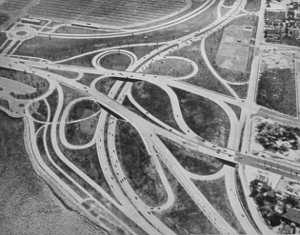



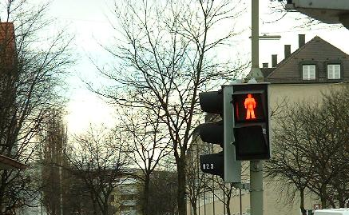
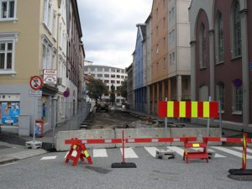

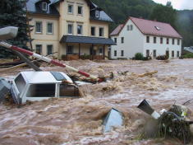
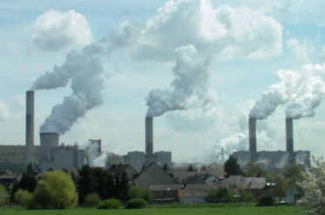
External Costs of Transportation - Overview
Land Consumption
Air Pollution
Noise
External Accident Costs
Additional Costs in Urban Areas
External Effects
External Costs
Up- and Downstream Processes
Infrastructure
Nature and Landscape
Climate Change

Slide 10
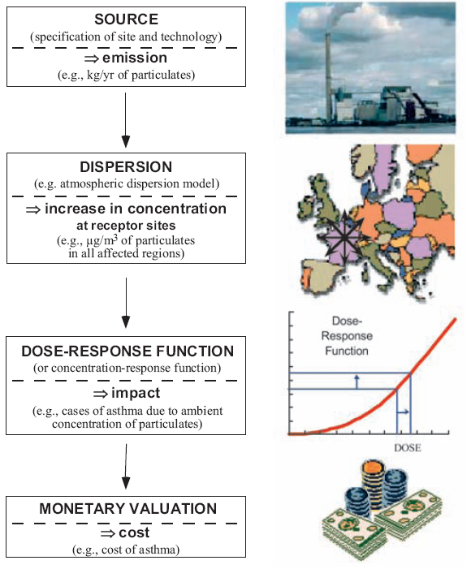
Impact-Pathway-Approach
Source: ExternE

Slide 11
Cost Factors CO₂

Slide 12
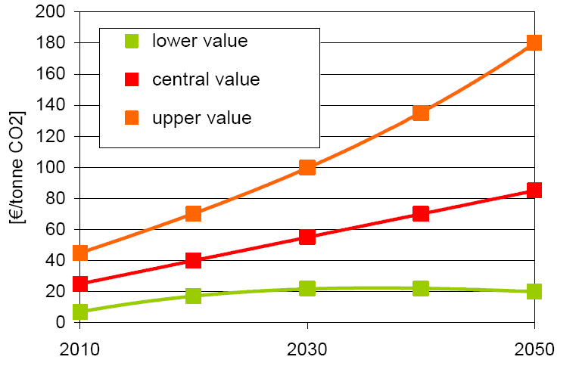
External Costs of Climate Change
Source: Maibach 2007

Slide 13
Cost curve = Least cost mitigation technologies Road transport EU27 in 2020 (lifetime payback, GHG)
By 2020:
Reduction potential at negative costs: 4%
Technical potential: 8% below 2020 baseline.
-4%
-8%
Euro / t CO2
Mt CO2eq
Data: A40 25/05/09
Source: Borken, 2009

